Slide 1
EENG 385
Pseudo Ramp Generator
Notes:
Usually the <title of the lab> is what will be called the “System” through the rest of this document

Slide 2
Lab Objectives
Analyze, assemble and test a circuit which generates a waveform that closely resembles a ramp waveform.

Slide 3
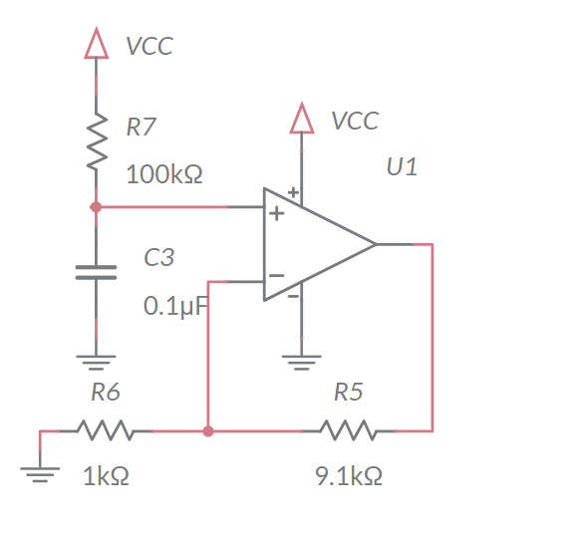
Analyze
The 0.1uF capacitor C3 charges towards VCC = 9V
  Charges for 888us then reset by 555 Timer
  The charging is close to a straight line
Notes:
Replace <System> with the name of the

Slide 4
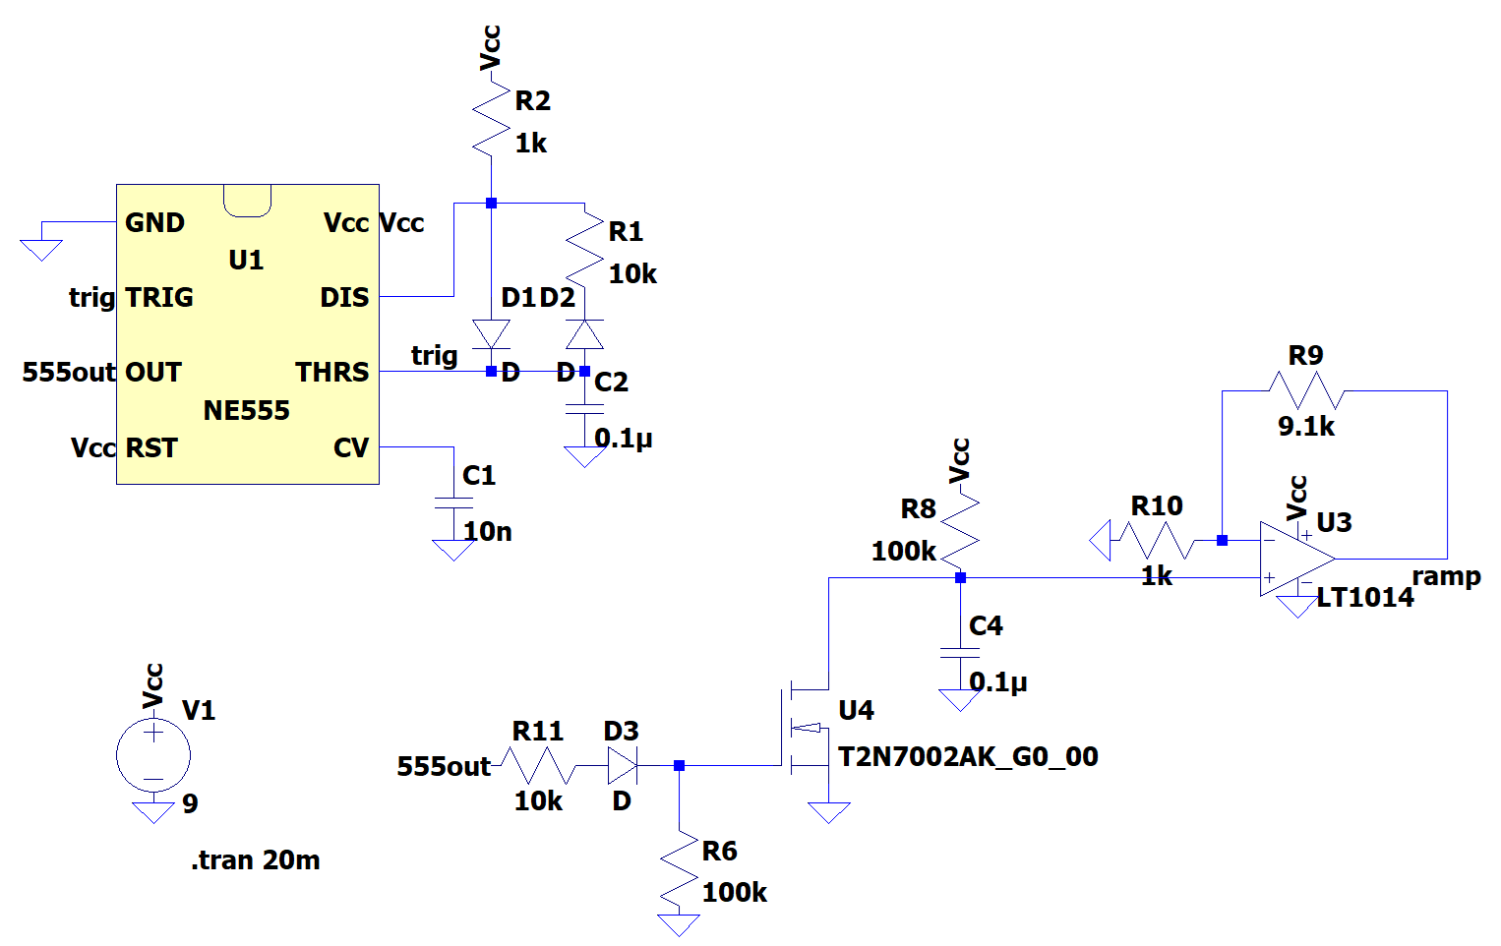
Simulate
Build in LTspice
  Charge on capacitor is cleared by MOSFET
  Do not include Schmitt Trigger Oscillator in simulation
Notes:
M86X55004

Slide 5
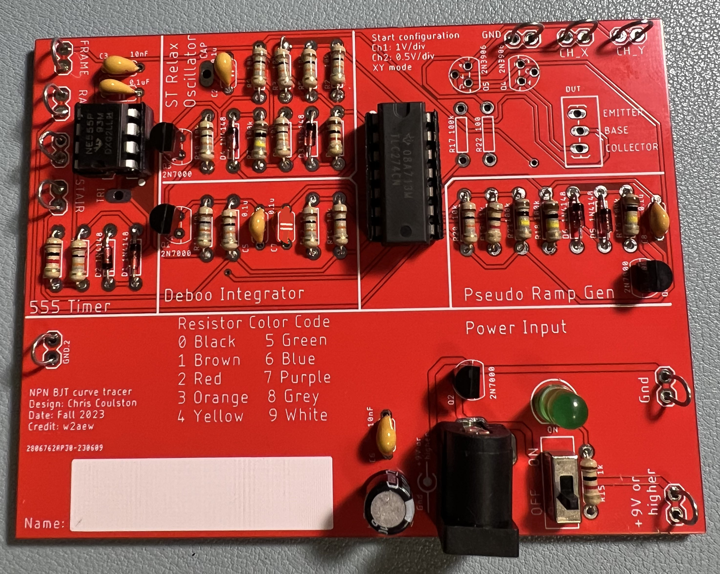
Assemble
Assemble
  2N7000 clears charge off cap
Notes:
Replace <System> with the name of the

Slide 6
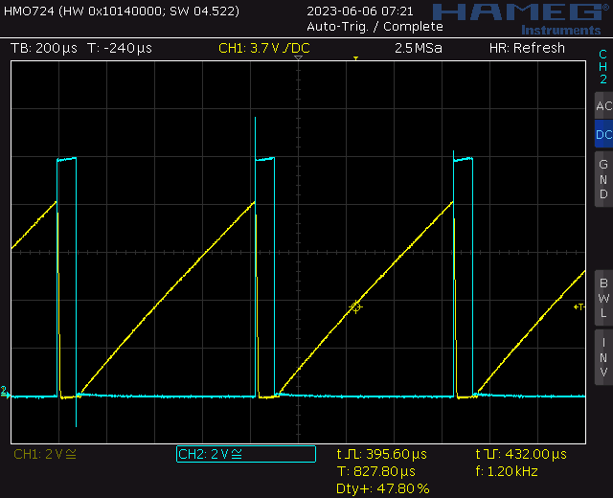
Test
Probe 555TIMER (blue) and RAMP (yellow)
Notes:
Replace <System> with the name of the

Slide 7
Turn In
Summary of analysis, simulation and assemble
Answer listed questions
Save solutions as PDF
Due before start of class next week
Every student builds their own board
Everyone brings their board to class

